Slide 1

Demystifying the Web
What is it that we do here?
What are we paying you for?

Slide 2

What does the Web do?
Why do I need a site?
What will a site do for my business?

Slide 3

Your Company, Your Site
The Internet is the fastest growing medium…EVER
Your customer base is searching for you already
Open virtually unlimited Marketing opportunities

Slide 4

What to do…
What do you want your clients to see?
Where do you want to send your clients?
What information do you want from your clients?
Most importantly, what domain name do you want?

Slide 5

Your Favorite Website…
Think of you favorite site. Whether you visit this site often, or just love the look of it.
What do you like?
Why do you come back?
What marketing do you receive from them?
What marketing do you see on the page?

Slide 6
What can my site do for ME?
Sell your items online…worldwide!
Sell your ideas
Get customers to come to YOU
Get client’s information
  Name
  Email
  Mailing Address
  Phone numbers
Give your clients information
Give your clients special incentives
Market to your heart’s content!

Slide 7
Do you really need a website?
Maybe “no”
  “I don’t know what to do with it”
  “I don’t need to reach anyone else”
  “My customers know who I am and where I am. They know what I do/sell.”
  “Customers won’t search for me or look for me online.”
Usually “YES”
  Online marketing opportunities
  Help YOUR clients find YOU
  Help potential clients find YOU
  24/7 access to you and your business!
  Email - personalized

Slide 8

I want a site…now what?
Figure out what you want to do with your site.
Think of a simple design.
  Example pages: “I like yahoo’s colors, but not the layout. I like the Google layout but not the colors.”
SignDog Web Questionnaire.

Slide 9

I need help…
Relax, that’s why we’re here.
Tell us your general idea; we’ll help you from there.
We can do everything from Site Design to Content Management Systems
Or, we can do very little

Slide 10
Content…what? A Blog?
Content Management System (CMS)
Allows YOU to control and modify the content
Don’t need to wait for us.
Can do during any hour – 24/7 access to your site’s content!
Blog (Weblog)
  You control the content.
  Clients/Users leave you feedback – comments
  Allows multiple users to publish content, each being attributed as such.
  It’s anything you want it to be! From life excerpts to business events.

Slide 11

My site's up…Done?
Not even, we’ve just begun!
We need to:
  Get your clients to find you (SEO)
  Get your site promoted – free or paid
  Keep the content from getting stagnant
  Know your competition and what they’re doing

Slide 12

Promotion…Get YOUR clients to find YOU
Search Engine Optimization
  This is getting your clients to find you.
  Knowledge is out there, you just need the time and ability to do so.

Slide 13
Search Engine Optimization
How will your clients find you?
What will they see when they search for YOU?

Slide 14
Words to know
SEO
  Search Engine Optimization
Organic Search
  People actively searching for YOU
Paid Search, AdWords
  YOU actively searching for clients
  Costs money!
Google
  Considered by many to be “the” search engine. Surprisingly, doesn’t have a strong market share outside of the US.

Slide 15
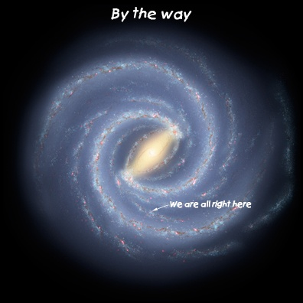
The World…Wide Web
Your Website is

Slide 16

How Google Works
A series of complex formulas that constantly evaluate the content of the site and compare it with other features of the site.
Also uses links.
Google likes your site better the less it has to rely on only your site.
NO ONE KNOWS!

Slide 17
How does Google find you site?
That’s where we come in!
We tell Google your site exists
We tell Google how your site is setup
We track how often and how Google is looking at your site, and make recommendations off of this data.
This is called Search Engine Optimization (SEO) in the industry.

Slide 18

Get Found
Great, you have a site, we’ve told Google about it. What about the others?
We do that too.
Google is known as the “king” of search engines.
Organic Searches vs. Paid Searches.

Slide 19
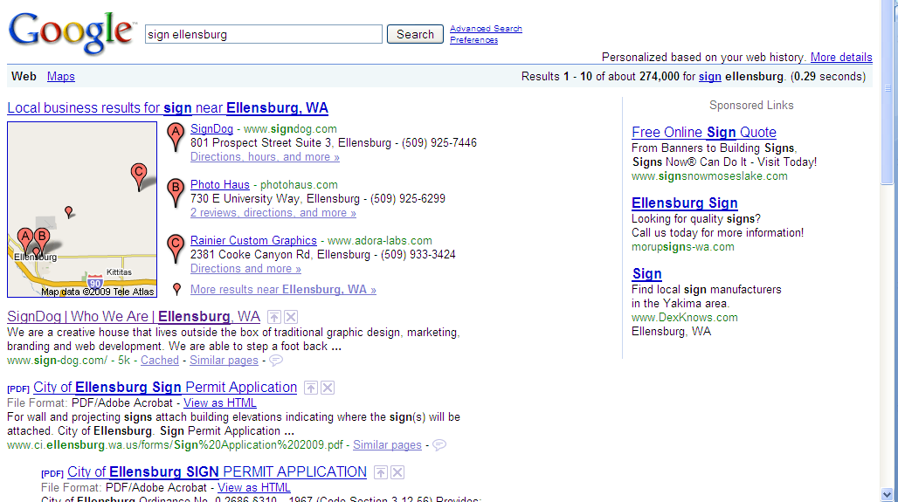
Organic Searches
The average user, searching for YOU
Can be broad or specific search terms
We need to know what keywords to focus on
Example time!

Slide 20
Search for The Dog
Search “sign ellensburg” in the big 3
Search “ellensburg sign” in the big 3
Keyword | Google.com position | Google.com URL | Yahoo (United States) position | Yahoo URL | Live position | Live URL
sign ellensburg | 1 | www.sign-dog.com/ | 14 | http://www.sign-dog.com/ | 2 | http://www.sign-dog.com/
Keyword | Google.com position | Google.com URL | Yahoo (United States) position | Yahoo URL | Live position | Live URL
ellensburg sign | 4 | www.sign-dog.com/ | 55 | http://www.sign-dog.com/ | 24 | http://www.sign-dog.com/

Slide 21
…BUT
Google has “Universal Search”

Slide 22
Paid Search
Costs YOU money when someone clicks on your advert.
Bid on keywords (and combinations)
Set a budget (daily, monthly, annual)
Design your Advert
Watch the results

Slide 23

Measuring Results
We do that too!
We use our internal tools as well as Google tools.
We can provide you with the results, even walking you through what you’re looking at.
We can measure down to the small details:
  Where you users are coming from
  What they’re doing on your site
  How they found you.

Slide 24

We're Here to Make YOU Secceed!
Our business is built upon you.
We want you to succeed above all your competitors
We back what we do and will fix anything within our domain.

